Slide 1
House Prices – Advanced Regression Techniques
Ames Housing dataset
Jim Kim

Slide 2
Problem statement
Build a predictive model that can accurately determine the home sale price
Data: https://www.kaggle.com/c/house-prices-advanced-regression-techniques

Slide 3
Data exploration
1460 rows x 81 columns
80 features + 1 target
37 numerical features
43 categorical features
19 features with missing values
PoolQC 99.520548
MiscFeature 96.301370
Alley 93.767123
Fence 80.753425
FireplaceQu 47.260274
LotFrontage 17.739726
GarageCond 5.547945
GarageType 5.547945
GarageYrBlt 5.547945
GarageFinish 5.547945
GarageQual 5.547945
BsmtExposure 2.602740
BsmtFinType2 2.602740
BsmtFinType1 2.534247
BsmtCond 2.534247
BsmtQual 2.534247
MasVnrArea 0.547945
MasVnrType 0.547945
Electrical 0.068493
Percentage of missing values per feature

Slide 4
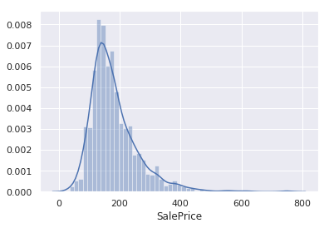
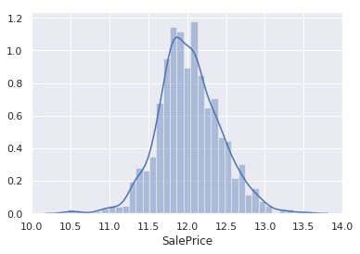
Data exploration
Skewness: 1.88
Kurtosis: 6.54
Skewness: 0.12
Kurtosis: 0.81
Not taking the logarithm
Taking the logarithm
Let’s keep in mind that taking the logarithm of the target (i.e. SalePrice) yields a normal distribution.

Slide 5
Missing values
For the following features, missing values has meaning:
Alley
Fence
MasVnrType
BsmtQual
BsmtCond
BsmtExposure
BsmtFinType1
BsmtFinType2
FireplaceQu
GarageType
GarageFinish
GarageQual
GarageCond
PoolQC
MiscFeature
For these 15 out of 19 features with missing values, we will fill missing values with N/A.
For these 4 out of 19 features with missing values, we will fill missing values…
Numerical columns: fill null values with median value
Categorical columns: fill null values with most common value (i.e. median)

Slide 6
Ordinal & categorical features
Upon looking at the data more closely, the following features were deemed ordinal and encoded accordingly.
ExterQual: Ex > Gd > TA > Fa > Po
ExterCond: Ex > Gd > TA > Fa > Po
BsmtQual: Ex > Gd > TA > Fa > Po > NA
BsmtCond: Ex > Gd > TA > Fa > Po > NA
BsmtExposure: Gd > Av > Mn > No > NA
BsmtFinType1: GLQ > ALQ > BLQ > Rec > LwQ > Unf > NA
BsmtFinType2: GLQ > ALQ > BLQ > Rec > LwQ > Unf > NA
HeatingQC: Ex > Gd > TA > Fa > Po
KitchenQual: Ex > Gd > TA > Fa > Po
Functional: Typ > Min1 > Min2 > Mod > Maj1 > Maj2 > Sev > Sal
FireplaceQu: Ex > Gd > TA > Fa > Po > NA
GarageType: Ex > Gd > TA > Fa > Po > NA
GarageCond: Ex > Gd > TA > Fa > Po > NA
PoolQC: Ex > Gd > TA > Fa > NA
Encode the remaining 29 categorical features using the LabelEncoder (sklearn.preprocessing).

Slide 7
Feature selection
Let’s determine which features are most correlated with the target, SalePrice.
Method: mutual_info_regression (sklearn.feature_selection)
The top 10 correlated features make intuitive sense
Consider building a model with just the closely correlated features
feature | importance
OverallQual | 0.573960
Neighborhood | 0.510229
GrLivArea | 0.481505
TotalBsmtSF | 0.368162
YearBuilt | 0.364497
GarageArea | 0.363187
BsmtQual_scaled | 0.355718
GarageCars | 0.353889
ExterQual_scaled | 0.336537
KitchenQual_scaled | 0.334630
Top 10 correlated features

Slide 8
Model fitting - results
Train-test split: 80-20
 | Model | sample_weight | alpha | train_r2 | test_r2 | train_rmse | test_rmse
1 | OLS | y_train | N/A | 0.863 | 0.852 | 32998.92 | 33495.48
7 | Ridge | N/A | 10 | 0.840 | 0.851 | 30865.65 | 33854.52
8 | Ridge | N/A | 100 | 0.840 | 0.851 | 30865.65 | 33854.52
4 | Ridge | N/A | 1 | 0.841 | 0.849 | 30797.74 | 34044.08
5 | Ridge | N/A | 0.1 | 0.841 | 0.849 | 30781.97 | 34079.23
6 | Ridge | N/A | 0.01 | 0.841 | 0.849 | 30781.41 | 34083.29
0 | OLS | N/A | N/A | 0.841 | 0.849 | 30781.41 | 34083.76
2 | OLS | y_train**2 | N/A | 0.900 | 0.863 | 37787.06 | 35360.61
3 | OLS | y_train**3 | N/A | 0.934 | 0.869 | 43884.66 | 39723.04
Hyperparameter tuning table

Slide 9
Model fitting - discussion
The best model was an ordinary least squares (OLS) linear regression with sample_weight set to y_train, yielding the smallest root mean square error (RMSE) of $33,495.48 (mean SalePrice is $180,921.20).
The difference between train and test RMSE is also the smallest, which indicates that the model is not overfitting as much as the other models.
The two OLS models with sample_weight set to y_train**2 and y_train**3 may be underfitting as the test RMSE is less than the train RMSE.
The spread of the residuals (prediction errors) is 18.5% of the mean SalePrice. This is less than 20%, making it an acceptable level of error.
Other observations
For the OLS models, increasing the power applied on the sample_weight yielded slightly higher R² but greater RMSE.
For the Ridge models, attenuating the coefficients more (i.e. higher alpha) yielded higher R² and lower RMSE; however, the same the RMSE did not go down when the alpha was increased from 10 to 100.

Slide 10
Future considerations
Options
Try different models (e.g. logistic regression, random forest)
Data cleaning (e.g. use a model to fill missing values)
Train models with just the closely correlated features
Include more features
More rows: get more data with the same features
More columns: 1) include new features 2) generate new features from original features
Prioritization
Generating new features from original features may yield the greatest reduction in root mean square error (e.g. squaring the original features)

Slide 11
The End

